Slide 1
Your New Favorite Song
A Song Recommender by Alex Tsai

Slide 2
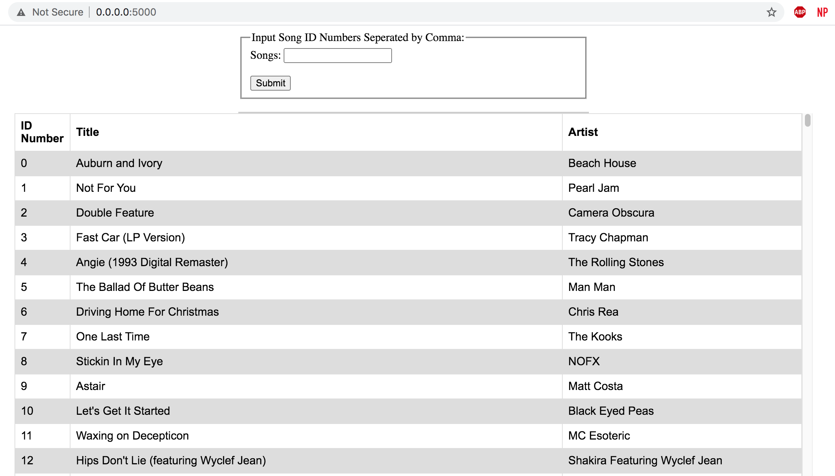

Slide 3
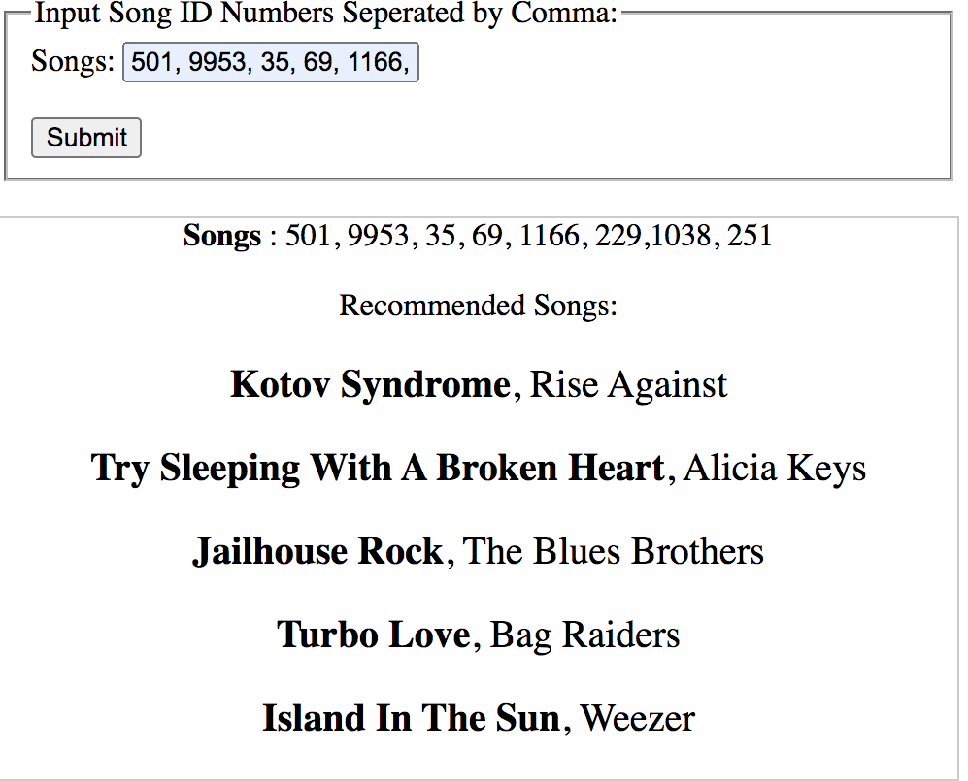

Slide 4
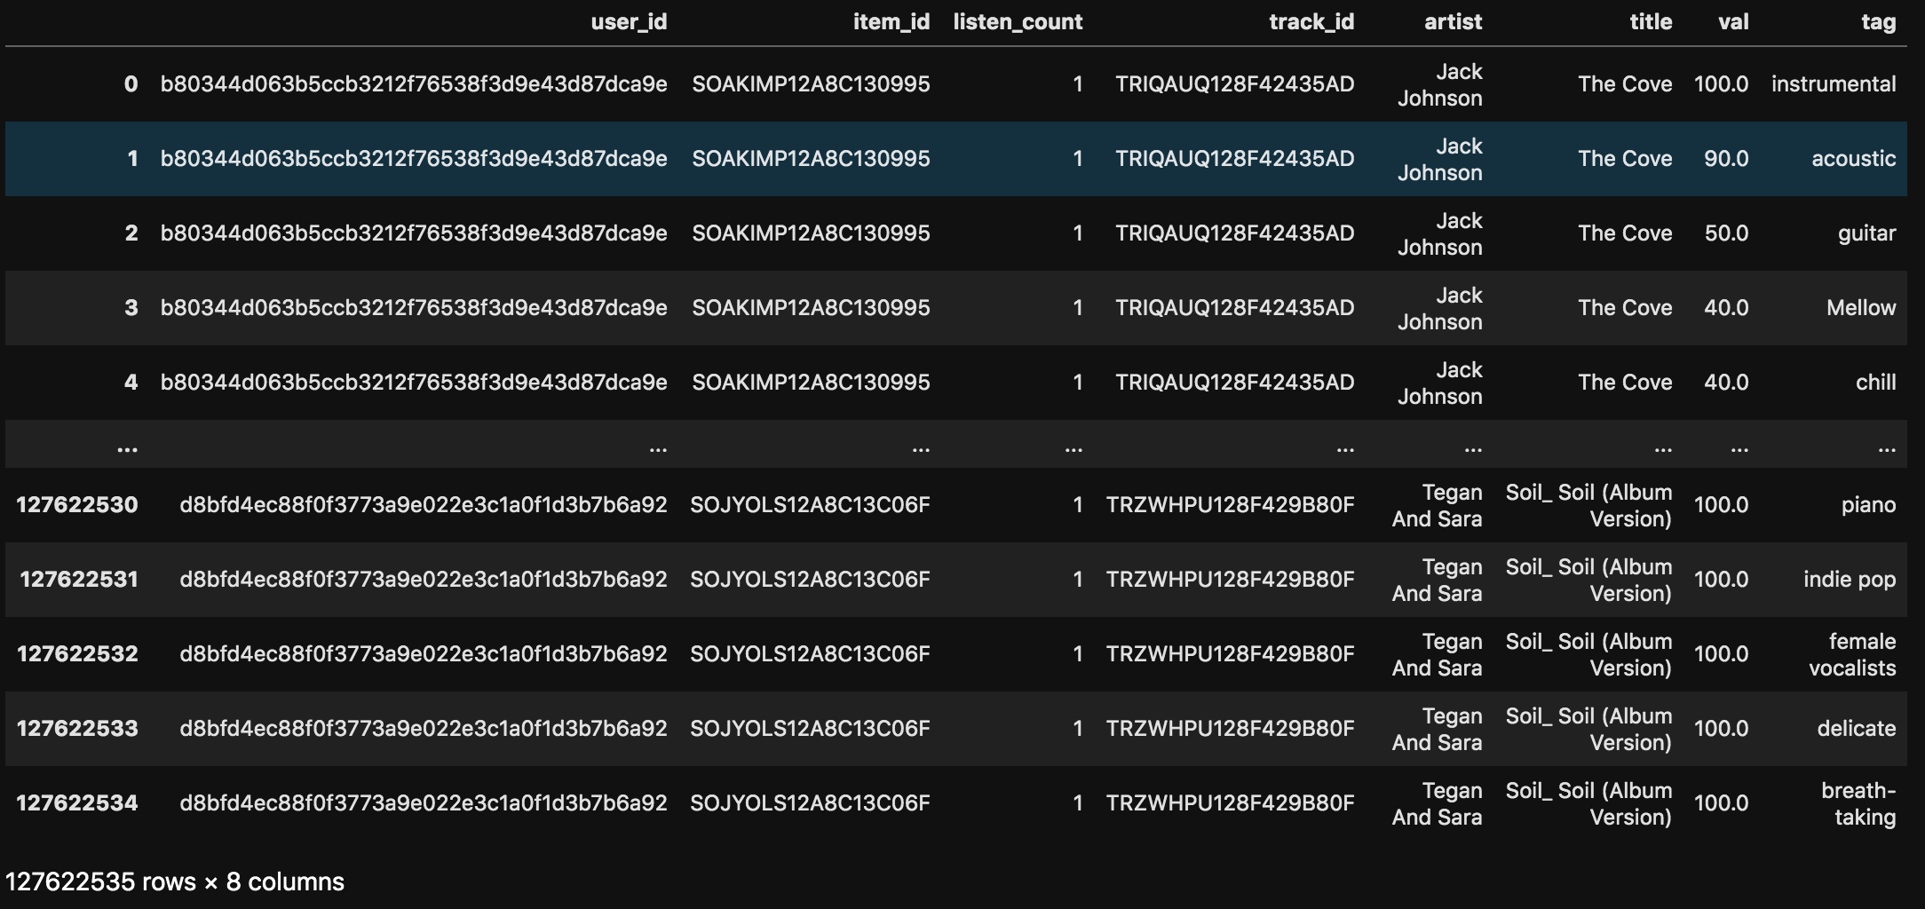
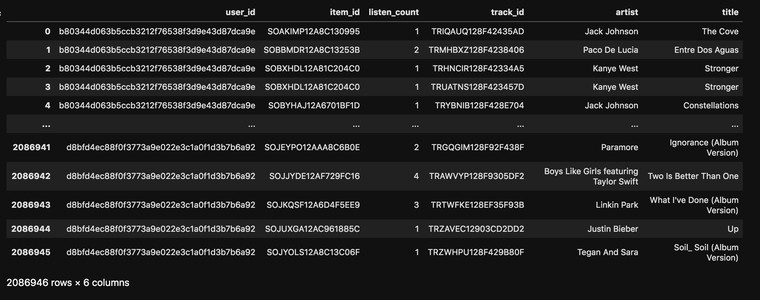
The Songs

Slide 5
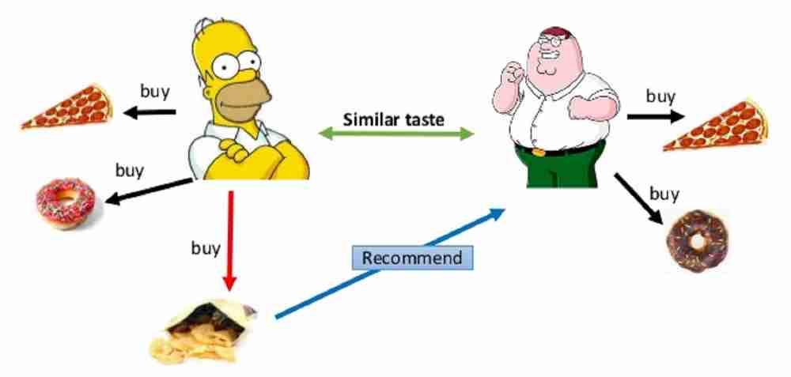
Collaborative Filtering
User Similarity
Recommends items to a user based on that user’s similarity with other users

Slide 6
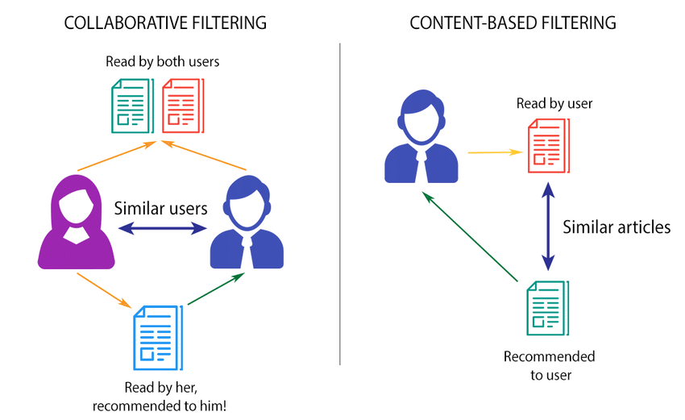
Content Based Filtering
Item Similarity
Recommend items to a user based on previous items that the user likes

Slide 7
The Songs

Slide 8
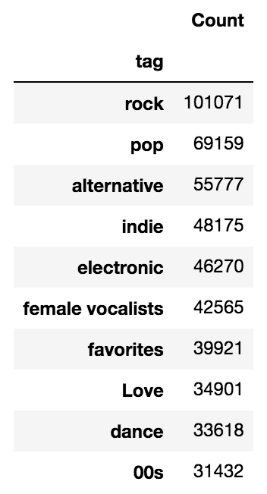
TAGS
Last.fm
522,366 Unique Tags
Use these tags to determine the similarities between songs

Slide 9

Light FM
Hybrid Model
Implicit
User and Item Features
WARP
Uses both Collaborative Filtering and Content Based Filtering
Positive if user has listened to song. Negative if user has not

Slide 10
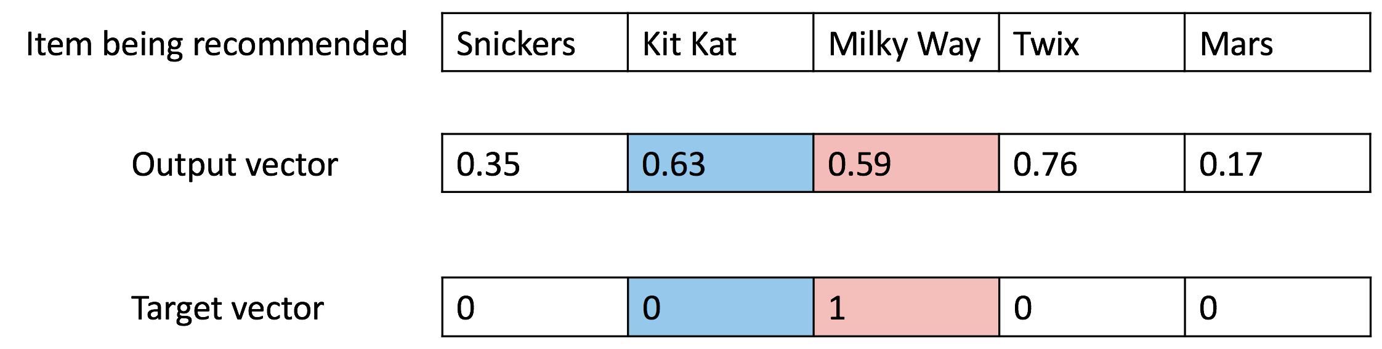
Warp
Takes positively rated items and compares their predicted scores against randomly sampled negatively rated items.
If the predicted scores for the negative item is higher than that of the positive item, the model updates.

Slide 11
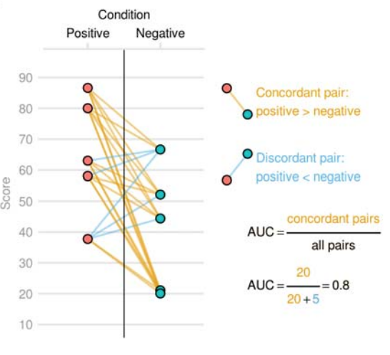
Model Evaluation
ROC AUC SCORE
AUC SCORE: 0.92
Probability that a randomly sampled positive item is rated higher than a randomly sampled negative item

Slide 12
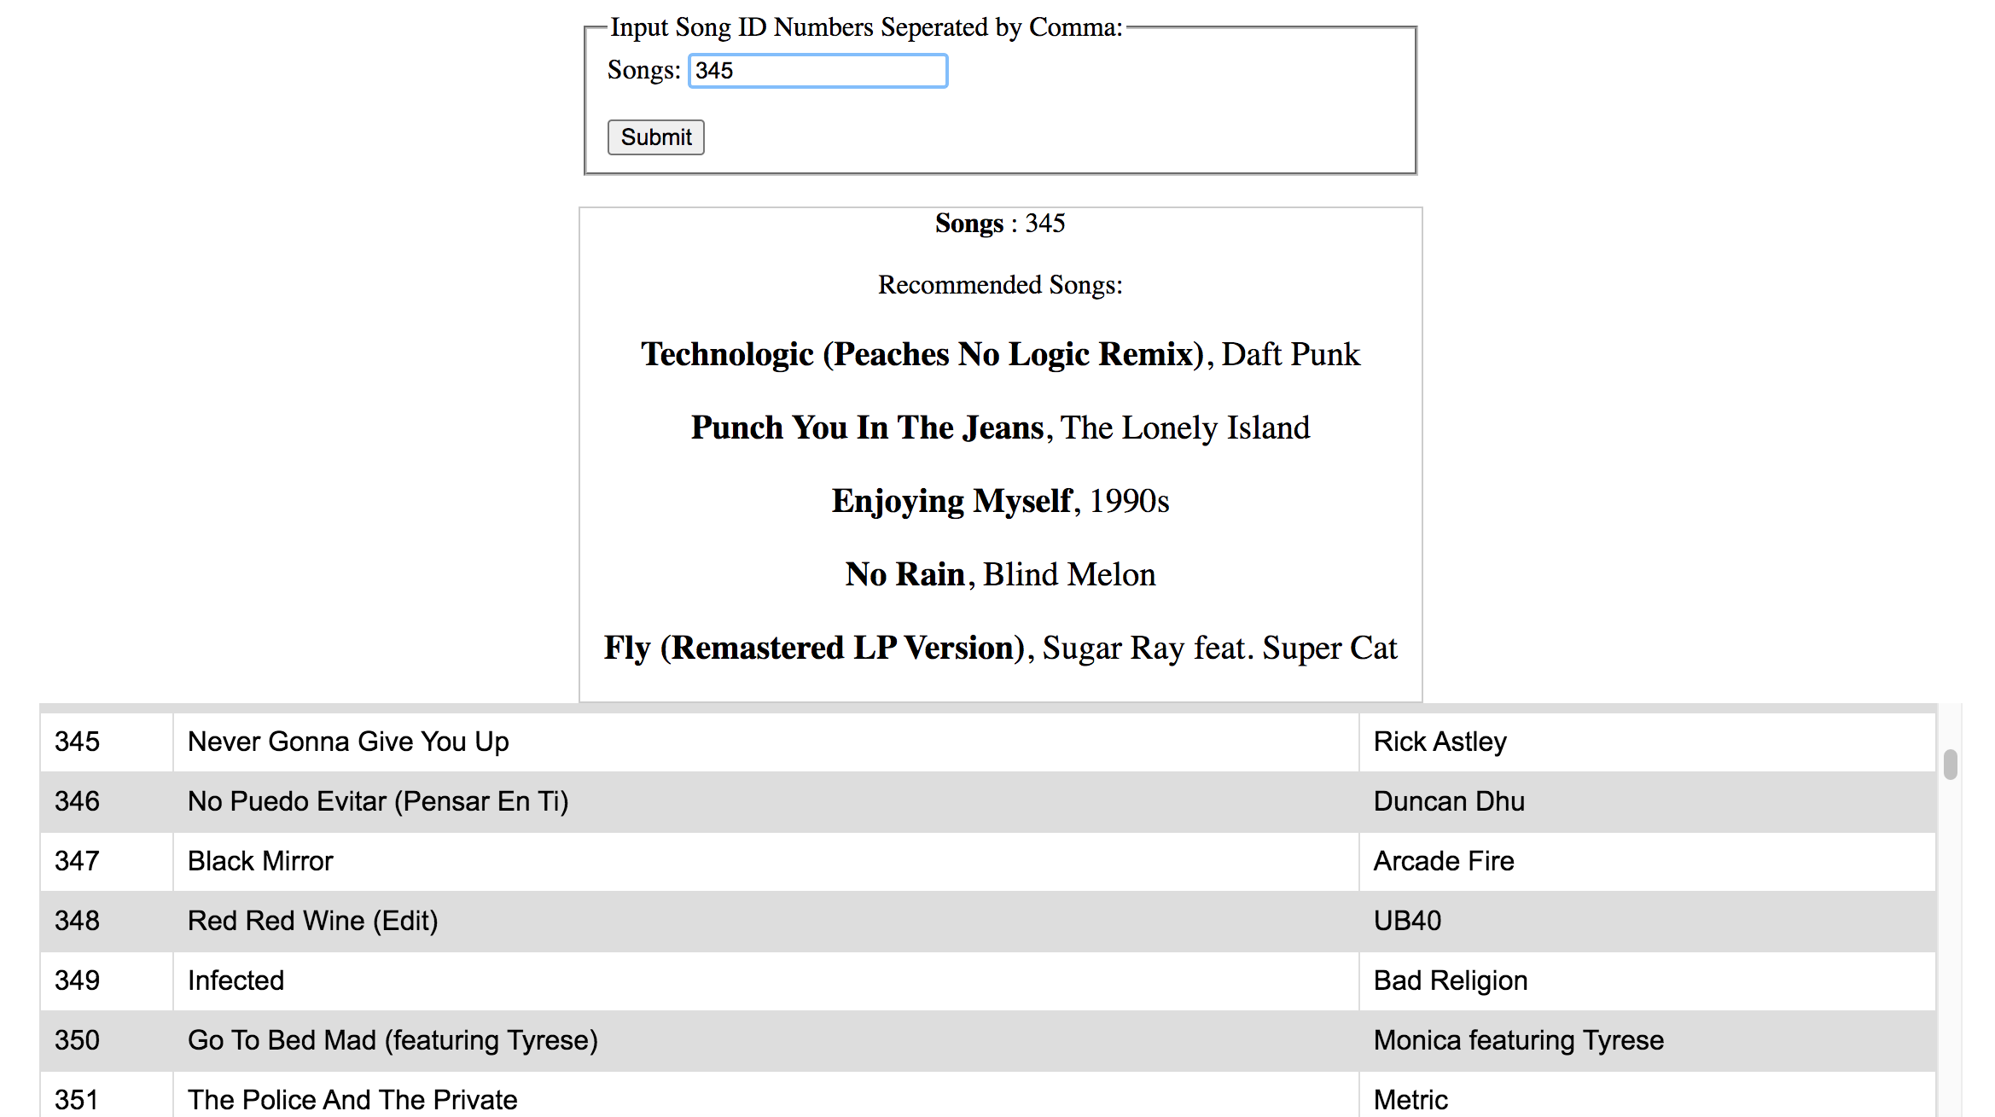

Slide 13
Thank You!

